Slide 1

Insights to an-
Automotive company on Electric vehicles launch in India
Presented by: Rohith Tallapalli

Slide 2

In-Depth Report
Answering questions like.....
The interest of Indians in EVs ?
Information about competitors ?
Which are the top 5 states with the highest EV sales? Why?
What are the top 5 states with the highest penetration rate?
The top state to set up a manufacturing plant?

Slide 3
Top and Bottom EV Makers-
𝐓𝐨𝐩 3 𝐄𝐕 𝐌𝐚𝐤𝐞𝐫𝐬 (2-Wheeler) -
FY 2023 - 1.OLA Electric 2.Okinawa 3.Hero Electric
FY 2024 - 1.OLA Electric 2.TVS 3.Ather
𝐁𝐨𝐭𝐭𝐨𝐦 3 𝐄𝐕 𝐌𝐚𝐤𝐞𝐫𝐬 (2-Wheeler) -
FY 2023 - 1.Jitendra 2.Being 3.Pure EV
FY 2024 - 1.Battre Electric 2.Revolt 3.Kinetic Green
𝐓𝐨𝐩 3 𝐄𝐕 𝐌𝐚𝐤𝐞𝐫𝐬 (4-Wheeler) -
FY 2023 - 1.TATA Motors 2.Mahindra & Mahindra 3.MG Motors
FY 2024 - 1.TATA Motors 2.Mahindra & Mahindra 3.MG Motors
𝐁𝐨𝐭𝐭𝐨𝐦 3 𝐄𝐕 𝐌𝐚𝐤𝐞𝐫𝐬 (4-Wheeler) -
FY 2023 - 1.Mercedez-Benz 2.Volvo Auto India 3.PCA Automobiles
FY 2024 - 1.Mercedez-Benz 2.KIA Motors 3.Volvo Auto India

Slide 4
𝐓𝐨𝐩 5 𝐬𝐭𝐚𝐭𝐞𝐬 𝐰𝐢𝐭𝐡 𝐭𝐡𝐞 𝐡𝐢𝐠𝐡𝐞𝐬𝐭 𝐩𝐞𝐧𝐞𝐭𝐫𝐚𝐭𝐢𝐨𝐧 𝐫𝐚𝐭𝐞 (in FY 2024) -
For 2-Wheeler -
For 4-Wheeler -
State | Penetration Rate
Goa | 18%
Kerala | 13.5%
Karnataka | 11.6%
Maharastra | 10.1%
Delhi | 9.4%
State | Penetration Rate
Kerala | 5.8%
Chandigarh | 4.5%
Delhi | 4.3%
Karnataka | 4.3%
Goa | 4.3%

Slide 5
𝐐𝐮𝐚𝐫𝐭𝐞𝐫𝐥𝐲 𝐭𝐫𝐞𝐧𝐝𝐬 𝐢𝐧 𝐬𝐚𝐥𝐞𝐬 𝐯𝐨𝐥𝐮𝐦𝐞 𝐟𝐨𝐫 𝐭𝐡𝐞 𝐭𝐨𝐩 5 𝐄𝐕
𝐦𝐚𝐤𝐞𝐫𝐬 (4-wheelers) -
Sales volume has been increasing with each quarter; however, in FY 2024, we saw a drop in sales in Q2.
𝐄𝐕 𝐬𝐚𝐥𝐞𝐬 𝐚𝐧𝐝 𝐩𝐞𝐧𝐞𝐭𝐫𝐚𝐭𝐢𝐨𝐧 𝐫𝐚𝐭𝐞𝐬 (Delhi vs. Karnataka for FY 2024) -
The penetration rate in Karnataka has noticeably increased from 2.1% to 4.3%, while that of Delhi has gradually risen from 3.7% to 4.3%. As a result, although Delhi used to have more EV sales than Karnataka every year, in FY 2024, Karnataka surpassed Delhi in terms of sales.

Slide 6

𝐂𝐀𝐆𝐑 𝐨𝐟 𝐭𝐨𝐩 5 𝐦𝐚𝐤𝐞𝐫𝐬 𝐢𝐧 𝐭𝐨𝐭𝐚𝐥 𝐯𝐞𝐡𝐢𝐜𝐥𝐞𝐬 𝐬𝐨𝐥𝐝 (4-Wheelers) -
Makers | CAGR
TATA Motors | 0.95
Mahindra & Mahindra | 1.40
MG Motors | 1.32
BYD India | 5.67
Hyundai Motors | 2.55

Slide 7
𝐓𝐨𝐩 5 𝐬𝐭𝐚𝐭𝐞𝐬 𝐰𝐢𝐭𝐡 𝐡𝐢𝐠𝐡𝐞𝐬𝐭 𝐂𝐀𝐆𝐑 𝐢𝐧 total 𝐯𝐞𝐡𝐢𝐜𝐥𝐞𝐬 𝐬𝐨𝐥𝐝-
For 2-Wheeler -
For 4-Wheeler -
State | CAGR
Tripura | 2.12
Goa | 1.60
Chandigarh | 1.55
West Bengal | 1.49
Chhattisgarh | 1.49
State | Penetration Rate
Uttar Pradesh | 5.61
Assam | 4.47
Punjab | 3.83
Haryana | 3.74
Odisha | 2.27

Slide 8
Peak and low season months for EV sales -
Peak Months-
March
November
May
Low Months-
June
July
April

Slide 9
For the top 10 states by penetration rate,
Based on CAGR from previous years,
Projected number of EV sales in 2030 -
State | Expected 2-Wheelers | Expected 4-Wheelers
Goa | 3013373 | 36916
Karnataka | 7010474 | 5176934
Delhi | 612376 | 386715
Kerala | 12554093 | 571904
Maharastra | 15848907 | 165844
State | Expected 2-Wheelers | Expected 4-Wheelers
Chhattisgarh | 6735229 | 1319414
Gujrat | 6340243 | 1390251
Rajasthan | 2128504 | 1612144
Odisha | 2395392 | 1983035
Tamil Nadu | 1532315 | 1305493

Slide 10

Revenue growth rate of 4-wheeler and 2-wheelers EVs in India for 2022 vs 2024 and 2023 vs 2024 -
Unit price considered as-
2-Wheeler - 85,000Rs.
4-Wheeler - 15,00,000Rs.
For 2 Wheelers,
Revenue has almost tripled from 21 billion in 2022 to 62 billion in 2023, showing 195% growth. However, in 2024, revenue only increased to 79 billion, showing a 27% growth. Hence, the overall growth from 2022 to 2024 is 276%.
For 4 Wheelers,
Revenue increased from 28 billion in 2022 to 71 billion in 2023, showing a 153% growth. However, in 2024, revenue further rose to 130 billion, showing an 83% growth. Hence, the overall growth from 2022 to 2024 is 364%.

Slide 11

Primary reasons for customers choosing
4-wheeler EVs in 2023 and 2024 -
Government Incentives - Various incentives are provided at both the state and central levels.
Rising Fuel Costs - With diesel and petrol prices soaring, EVs appear to be more cost-effective.
EV technology advancements - EVs are continually evolving with new innovations.
Reduced Operating Costs - The overall operating and maintenance costs of EVs are lower.
Environmental Concerns - EVs exert less strain on the environment.

Slide 12
How do government incentives and subsidies impact the adoption rates of 2-wheelers and 4-wheelers?
1. Central Government Incentives (FAME-II Scheme):
FAME-II (Faster Adoption and Manufacturing of Hybrid and Electric Vehicles): Launched in 2019, this scheme offers financial incentives to reduce the cost of EVs.
For Two-Wheelers: Rs 15,000 per kWh of battery capacity, covering up to 40% of the vehicle's cost.
For Four-Wheelers: Rs 10,000 per kWh of battery capacity, with a maximum subsidy of Rs 1.5 lakh.
GST Reduction: EVs are subjected to a reduced Goods and Services Tax (GST) of 5%, significantly lower than the 28-50% GST on petrol and diesel vehicles.
Tax Benefits: First-time individual EV buyers who take a loan can avail of tax deductions of up to Rs 1.5 lakh on the interest paid, under Section 80EEB of the Income Tax Act.

Slide 13
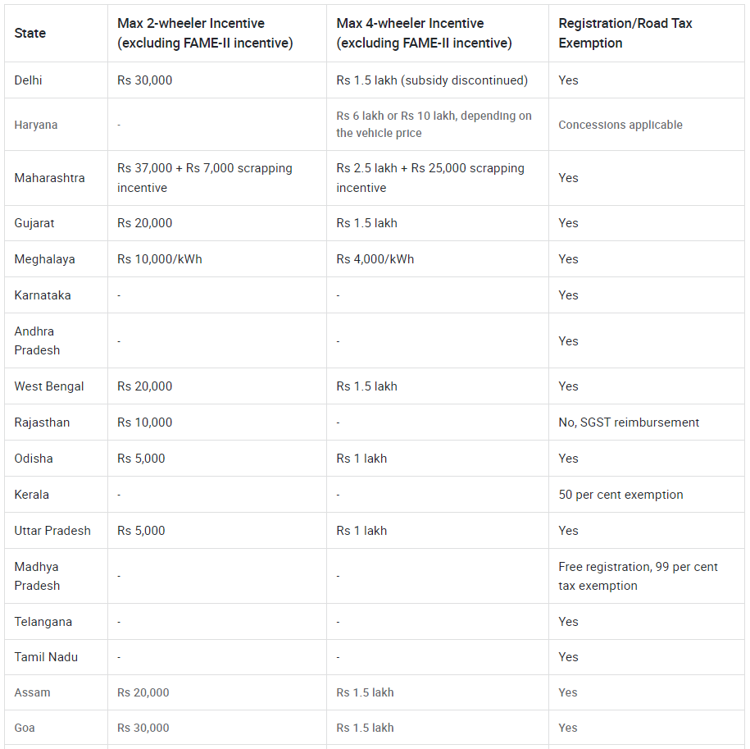
Which states in India provided most subsidies?
2. State Government Incentives:
Varied State Subsidies: Each state offers different subsidies and incentives, which often complement the central FAME-II benefits. These can include additional subsidies on vehicle costs, exemptions from registration fees, and road tax waivers.
1.Maharashtra 2.Haryana 3.Delhi

Slide 14
3. Charging Infrastructure Support:
Central and State Initiatives: To support EV adoption, both central and state governments are investing in setting up charging stations across the country. This includes directives from the central government and state-specific policies offering incentives to companies building charging infrastructure.
Read full article here,

Slide 15
How does the availability of charging stations infrastructure correlate with the EV sales and penetration rates in the top 5 states?
State | operational public EV charging stations
Delhi | 1886
Karnataka | 1041
Maharashtra | 3079
Kerala | 852
Tamil Nadu | 643
All these states are among the top in terms of penetration rate. Hence, the charging station infrastructure shows a noticeable impact.
*(As of 02/02/2024 )
Reference- https://pib.gov.in/PressReleaseIframePage.aspx?PRID=2003003

Slide 16

Who should be the brand ambassador if AtliQ Motors launches their EV/Hybrid vehicles in India and why?
Ranveer Singh would be a great choice as a brand ambassador. He is known for his energy. His powerful actions and energetic performances have always been my favorite.

Slide 17

Which state of India is ideal to start the manufacturing unit? (Based on subsidies provided, ease of doing business, stability in governance etc.)
Considering various factors such as subsidies provided, ease of doing business, stability in governance, and the manufacturing plant locations of competitors,
I recommend the following states:
1.Tamil Nadu
( OLA Electric, Ather, Ampere, BYD )
2.Gujarat
( Tata, MG Motor )
3.Maharastra
( Bajaj )

Slide 18

Your top 3 recommendations for AtliQ Motors.
Innovation: After every new EV launch, buyers are always curious about the new features, such as auto-driving, side cameras, auto-parking, etc. Therefore, innovation plays a vital role in capturing the attention of new customers.
Extended Range and Faster Charging: Although EVs have made significant advancements in recent years, many people still avoid using them for long-distance travel due to their limited range and lengthy charging times. EV companies that can address these issues will gain a significant competitive edge.
Enhanced Safety Features: Buyers definitely take car safety ratings seriously.

Slide 19



Mail
Linked in

